Slide 1




TYPE OF INTRUSION DETECTION SYSTEM
TYPE OF INTRUSION DETECTION SYSTEM

Slide 2



CLASSIFICATION
  Signature Vs Anomaly Based
  Active Vs Passive
  Host Vs Network
  Centralize vs Distributed
  Real Time Vs Interval

Slide 3

Signature Recognition
  Catch the intrusions in terms of the characteristics of known attacks or system vulnerabilities.
  Best for: Detecting known attacks.
  Example: If a packet matches a known malware signature, the IDS triggers an alert.
WAYS TO DETECT
Anomaly Detection
  Detect any action that significantly deviates from the normal behavior.
  Best for: Detecting unknown or new attacks.
  Example: A user logging in at 3 AM with unusually high data transfers may trigger an alert.

Slide 4

What is it?
Analogy
  Signature-based detection compares incoming data or actions against predefined patterns of known attacks
  Imagine a security guard checking faces against a wanted poster. If someone matches the poster, the guard sounds the alarm. That’s how signature detection works, by recognizing known attackers
SIGNATURE RECOGNITION
How does it work?
What is Signature?
  Just like antivirus software matches virus definitions, a signature-based IDS.
  Detection occurs when a matching malicious behavior is observed
  Signature = Pattern of Code
  Patterns of known threats, like viruses, exploits, or malicious commands. If a match is found, the system raises an alert.

Slide 5

METHODOLOGY

Slide 6
ADVANTAGE
Known Threats
Low False Positive
Fast Detection
Detects threats precisely if a matching signature exists.
Since it only alerts on known patterns, it rarely flags normal behavior as malicious.
Immediate response once a known signature is matched.

Slide 7
DISADVANTAGE
Cannot Detect Unknown Attacks
Requires Regular Updates
Limited Flexibility
Misses new or modified (zero-day) threats not in the database.
Needs continuous signature updates to stay effective.
Only useful against previously identified threats.

Slide 8
What is it?
A method that identifies deviations from normal behavior in a system, network, or user activity. Once the baseline is established, it monitors system activity and raises alerts when it detects activity that significantly differs from this normal pattern.
ANOMALY RECOGNITION
How It Works?
  Learn Normal Behavior
  Monitor Current Activity
  Detect Deviations ( A change or difference from what is normal, expected, or usual behavior.)
Analogy
Anomaly-based detection is like having a security guard who knows your daily routine. If something unusual happens, the guard may suspect something’s wrong even if he doesn't know exactly what.

Slide 9
METHODOLOGY

Slide 10
ADVANTAGE
Detects Unknown/Zero-Day Attacks
Monitors Behavioral Changes
Adaptive to New Environments
Identifies suspicious behavior even if the threat is new.
Good for spotting insider threats or unusual user actions.
Can adjust to new patterns over time with proper training.

Slide 11
DISADVANTAGE
High False Positive Rate
Requires Training Period
Complex Configuration
Normal but unusual activities can trigger alerts.
Needs time to learn what “normal” behavior looks like.
More challenging to maintain and fine-tune than signature-based systems.

Slide 12
COMPARISON
COMPARISON
01

Slide 13

SIGNATURE
ANOMALY
  Uses known attack signatures or patterns
  Detects deviations from normal behavior
  Very effective for known attacks
  Good for detecting unknown or zero-day attacks
  Fast, since it matches against known patterns
  Slower, due to analysis and behavior comparison
  Easier to maintain; just update signatures
  Harder; needs tuning and baseline adjustment
Snort, Suricata (using signature rules)
ML-based IDS, systems that monitor behavior trends

Slide 14
TYPE OF INTRUSION DETECTION SYSTEM
Host Based IDS (HIDS)
Network Based IDS (NIDS)
Hybrid
  Installed on a computer to detect suspicious activity inside the system.
  Monitors network traffic to catch external threats.
  Combines both HIDS and NIDS for stronger and more complete protection.

Slide 15

HOST-BASED IDS (HIDS)
Host‐based intrusion detection systems or HIDS are installed as agents on a host
Host‐based IDSs check for intrusions by checking information at the host or operating system level.
These IDSs examine many aspects of your hosts, such as system calls, audit logs, error and messages logs. To detect any intruder activity.

Slide 16
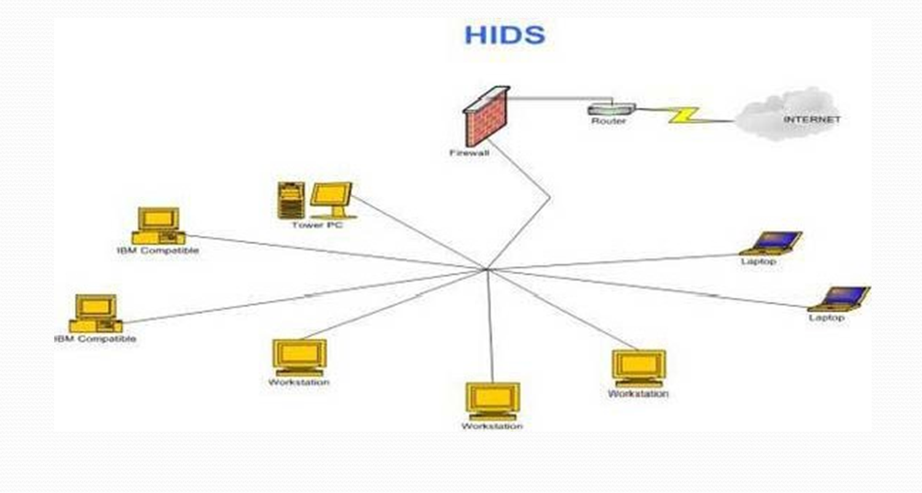

Slide 17
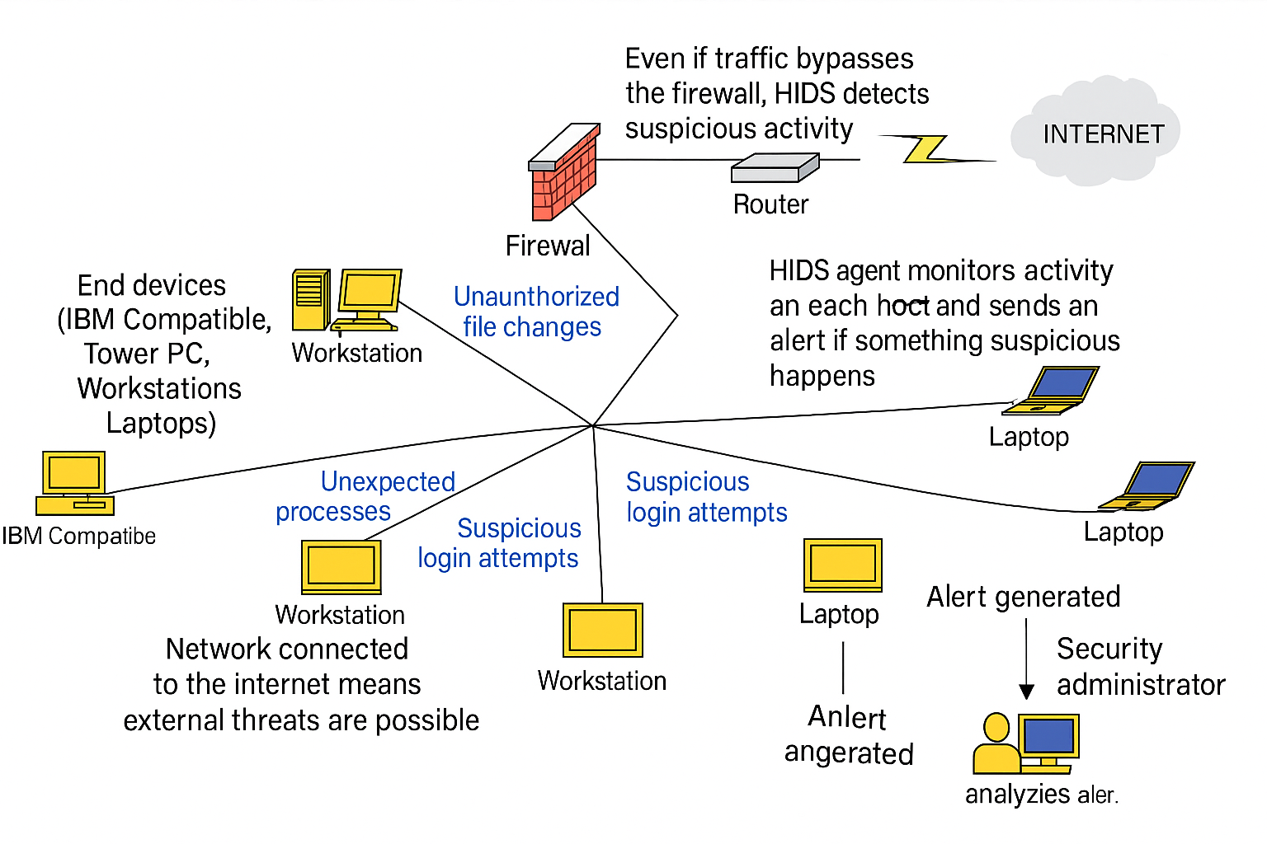

Slide 18
EXPLANATION OF THE DIAGRAM
Diagram Components
1) End Devices (Tower PC, Workstations, Laptops)
  Each of these computers has a HIDS agent installed.
  The agent monitors activity on that specific machine and sends alerts if something suspicious happens.
2) Firewall & Router
  These are part of the network perimeter but are not part of HIDS itself.
  Even though they filter traffic, HIDS works inside the hosts, not at the perimeter.
3) Internet Connection
  The diagram shows the network connected to the internet, meaning external threats are possible.
  HIDS will detect suspicious activity that has already bypassed the firewall or originated internally.

Slide 19





HOW THIS SETUP WORKS?
Step by step
HIDS agent installed on every device in the network.
HIDS Agent keep monitors activity
When the agent detects something suspicious:
    Generates an alert.
    Sends it to the central management system (if used) or directly to the security team.

Slide 20

ADVANTAGE
DETAILED HOST-LEVEL MONITORING
CAN DETECT ENCRYPTED ATTACKS
ACCURATE USER ACTIVITY TRACKING
  Can detect changes in files, configurations, and logins inside the system.
  Many modern threats are hidden inside encrypted traffic (HTTPS, VPN, SSH).
  HIDS can track which user accounts perform specific actions on the system.
  It can detect suspicious activities that network monitoring might miss especially those that happen entirely inside the host without involving network traffic.
  Works after traffic is decrypted, so it catches threats NIDS might miss.
  For example, if a privileged account creates or deletes system files at unusual times, HIDS can log and alert on that behavior.

Slide 21
DISADVANTAGE
NO NETWORK-WIDE VIEW
CONSUMES HOST RESOURCES
VULNERABLE IF HOST IS COMPROMISED
  HIDS can only protect and monitor the host it’s installed on.
  Because HIDS is installed directly on the machine, it uses CPU, RAM, and storage to process logs, monitor activity, and maintain alerts.
  If an attacker gains full control of a host (root/admin access), they can disable, alter, or erase HIDS logs.
  If an attack is targeting other systems in the network, the HIDS won’t see it.
  This makes HIDS less effective if the system’s integrity is already broken.

Slide 22

NETWORK BASED IDS (NIDS)
NIDS (Network-based Intrusion Detection System) is a security tool that monitors and analyzes network traffic in real time to detect suspicious or malicious activity.
It capture data packets traveling on the network media (cables, wireless) and match them to a database of signatures
Depending upon whether a packet is matched with an intruder signature, an alert is generated or the packet is logged to a file or database.

Slide 23
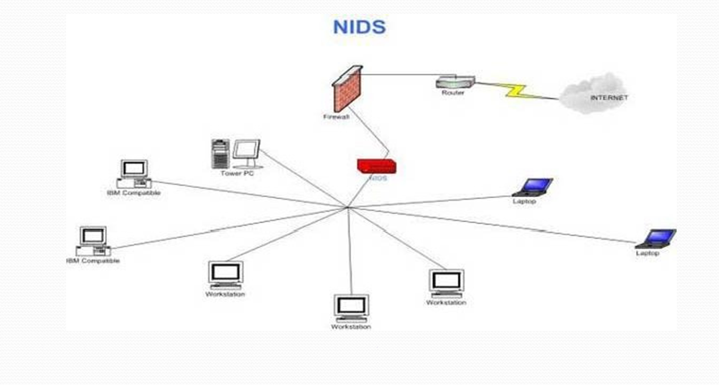

Slide 24
EXPLANATION OF THE DIAGRAM
Diagram Components
1) Internet → Router → Firewall
  Traffic from the internet first reaches the router, then goes through a firewall.
  The firewall filters unwanted traffic based on predefined rules.
2)NIDS Placement
  The NIDS device is positioned inside the network, typically behind the firewall.
  This allows it to monitor both inbound and outbound traffic for suspicious activity.
  It analyzes network packets to detect intrusions, malware, or policy violations.
3)Internal Network
  Multiple devices are connected to the network
  The NIDS monitors the traffic flowing to and from these devices without interfering (passive monitoring).

Slide 25


HOW THIS SETUP WORKS?
Step by step
Traffic Enters the Network
NIDS Listen to Traffic
Detecting Suspicious Activity
Packet Analysis
Data from the internet flows through:
  Router – directs the traffic to the correct destination.
  Firewall – blocks or allows traffic based on security rules.
  The NIDS device is connected in a way that it can “see” all the data traveling across the network (inbound & outbound).
  It does not block traffic instead, it copies the packets for inspection.
NIDS analyzes both parts using:
  Signature-based detection
  Anomaly-based detection
  This analysis happens in real-time so threats can be flagged immediately
Detecting Suspicious Activity
Examples:
  A workstation sending data to an unknown foreign server at 3 AM.
  A laptop trying to run port scans on other devices.
  Malicious code hidden inside network packets.

Slide 26
ADVANTAGE
CENTRALIZED MONITORING
NO PERFORMANCE IMPACT ON DEVICES
REAL-TIME DETECTION
  Monitors the whole network from a single point without needing software on each device.
  NIDS operates on a separate device or server, not on the user’s machine.
  NIDS analyzes packets as they move across the network.
  It’s easier to maintain compared to installing software on every device.
  Users can work normally without even noticing the NIDS is there.
  Alerts are generated immediately when suspicious patterns are found.

Slide 27
DISADVANTAGE
CAN’T SEE ENCRYPTED TRAFFIC
MISSES LOCAL ATTACKS
FALSE POSITIVES
  If traffic is encrypted (HTTPS, VPN, SSH), NIDS cannot inspect the packet contents.
  NIDS focuses on network traffic, so it can’t see what happens inside a single host.
  Normal but uncommon activities may be flagged as suspicious.
  This can overwhelm administrators with unnecessary alerts.
  Malicious payloads inside encrypted streams may pass unnoticed.
  Attacks like local privilege escalation or file tampering may bypass detection.
  Over time, too many false positives may cause real threats to be ignored.

Slide 28
COMPARISON
COMPARISON
01

Slide 29
HIDS
NIDS
  Installed on a specific host (computer or server).
  Placed at a strategic point in the network.
  Monitors activities of one host only.
  Monitors traffic for the entire network segment.
  Uses system logs, file changes, and OS-level activity.
  Uses packet captures and network traffic analysis.
  Detects successful attacks on the host, even after they bypass the network.
  Detects attacks in transit before they reach hosts.
Example: OSSEC, Tripwire, AIDE (Advanced Intrusion Detection Environment)
Example: Snort, Suricata, Bro/Zeek

Slide 30

HYBRID IDS
A Hybrid Intrusion Detection System combines the features of Host-based IDS (HIDS) and Network-based IDS (NIDS) into one system.
Correlates information from multiple sources, reducing false positives and false negatives compared to using HIDS or NIDS alone.
Detects both external attacks before they reach hosts and internal threats that originate inside the network.

Slide 31
HOW IT WORKS?
Step by step
1) Data Collection
  The Hybrid IDS has network sensors (like NIDS) that capture packet data from the network.
  It also has host agents (like HIDS) installed on individual systems to monitor logs, file changes, and processes.
2) Centralized Analysis
  Both types of data are sent to a central management console.
  The system correlates the information. For example, if the NIDS detects a suspicious connection and the HIDS sees unusual file changes on the same host, it’s likely a real attack.
3) Response
  Hybrid IDS can be passive (alert only) or active (block suspicious activity, similar to IPS).
  The system can automatically update detection rules to respond to new threats faster.

Slide 32
CLASSIFICATION
CLASSIFICATION
01

Slide 33
ACTIVE IDS
PASSIVE IDS
  Not just monitoring . It takes action when it detects threats
  Detects and alerts but does not take direct action.
  Can block or modify network traffic
  Requires admin or user to respond to threats.
  Often called Intrusion Prevention Systems (IPS).
  Works like a CCTV . Watches but can’t stop intrusions.
Snort (IPS mode), Suricata (IPS mode)
Zeek, OSSEC, Tripwire

Slide 34
CENTRALIZED IDS
DISTRIBUTED IDS
  Uses multiple agents/sensors spread across locations.
  All monitoring and analysis happen in one central system.
  Better for large or complex networks.
  Easier to manage and maintain.
  May struggle with high-speed data streams.
  Requires secure communication between detection points.
Example: Cisco Secure IDS centralized console.
Example: Wazuh with agents on multiple hosts.

Slide 35
REAL TIME IDS
INTERVAL IDS
  Analyzes data at scheduled times (hourly, daily).
  Detects and responds immediately.
  Suitable for stopping fast-moving threats.
  Slower — threats may already have occurred before detection.
  Critical for sensitive or high-value systems.
  Good for environments where immediate action isn’t critical.
  Threats may remain active before detection occurs.
  Requires more processing power and continuous monitoring.
Snort, Suricata in Live Mode
AIDE or Tripwire on daily scan schedule

Slide 36
CONCLUSION
CONCLUSION

Slide 37
Intrusion Detection Systems (IDS) are an important part of network and system security. They can be classified in several ways:
  By detection method – Signature-based (detects known attacks quickly but cannot find new ones) and Anomaly-based (detects unusual activity and can find new threats, but may give false alarms).
  By location – Host-based IDS (HIDS) monitors activity on a single computer or server, while Network-based IDS (NIDS) monitors traffic across the network.
  By combination – Hybrid IDS uses features from different types to improve detection.
  By response type – Active IDS can take action (like blocking an IP), while Passive IDS only alerts the user.
For strong protection, organizations often use a mix of IDS types. This ensures they can detect both known and unknown attacks, protect both individual devices and entire networks, and respond effectively to threats. Understanding these types helps students design better security strategies in real-world situations.

Slide 38
THANK YOU FOR YOUR ATTENTION

